Slide 1
Portfolio Website Presentation
By Quinn Outram

Slide 2
What is this ‘Portfolio Website’?
The website is a static set of HTML pages styled with CSS with a little bit of JavaScript sprinkled in for functionality. The reason this website was created was to display basic competence with HTML, CSS, Git, Documentation and JavaScript. In addition, this website also gives the user a platform to display their achievements and projects in an easily accessible platform to deliver to employers and recruiters.
Features of this website
Static HTML webpages
CSS Styling
Interactive and animated header made possible with JavaScript
Small interactive animations (i.e. site links highlighting on hover on desktop growing images etc.)
Easy to access resume, projects, contact information and personal information.
Blog page with access to five full text articles
Landing page with typing animation

Slide 3
Design Process
Before starting on this project several design decisions were made to ensure compatibility across devices, consistency across pages and effective delivery of the project. These core decisions were as follows:
The project would have a sitemap and wireframes built before production of the site. This ensured that I delivered what was required in a consistent fashion with compatibility designed for all device types.
The color scheme used would be mono cyan blue (https://www.shutterstock.com/color/cyan-blue) this would ensure constancy throughout the website(plus I LOVE the color).
I wanted to use a consistent body background throughout every webpage this again ensured consistency and tied the whole project together.
When beginning production I would ensure it was coded in a mobile first approach to maximize accessibility.
As this was my first major website project I decided to attempt to keeping the designs simple rather than complex

Slide 4
Components
In building this website I created several different components which could be used throughout every page on this website. These included:
A responsive header including a hamburger menu animated ‘button’ (This could be considered its own component within the header was difficult as I had never done this before… more on this later)
A footer including copyright information.
A base background image nested within the body
The whole blog-post.html(1-5) is completely reusable all you have to do is change the image src as well as the read-time/post-time/blog-content(I know this is not strictly a component of a html page however it is reusable and has been so I figured it worth mentioning)
Similarly, to above the project components can be reused throughout the project page to account for different projects to maintain a uniform appearance and easily include any recently completed projects
Single use components included:
Project and Blog preview blocks which were only used in their respective pages but replicated throughout them to contain different projects/blog-post previews
An interactive resume download button on the contact page which animation makes it change color when the user hovers over it
A grow animation which makes a cartoon portrait grow to its final size when the user accesses the about me page.

Slide 5
Design/Component decisions
The website was designed to be interactive and engaging so the user continues to explore and enjoy the website. Some examples of this include:
Hover interactions on header anchors change the color of them to give the user a feeling of intractability (This encourages the user to interact with a click on these anchors)
Animation of the hamburger menu to engage the user as they click entertaining them with an animation
Animated cartoon portrait in the about me page to engage the viewers

Slide 6
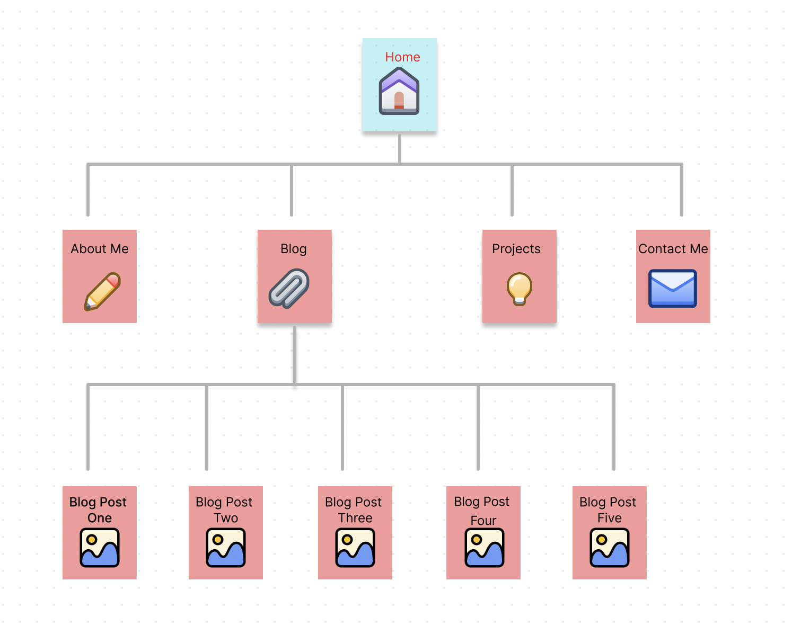
Website Sitemap
This website has a basic navigation functionality with most pages being accessible from the header (About Me, Blog, Projects, Contact Me) that is at the top of every page. The only exception to this is the full text blog posts which can be accessed via the blogs page by clicking on the blog post in questions [read more] text.

Slide 7
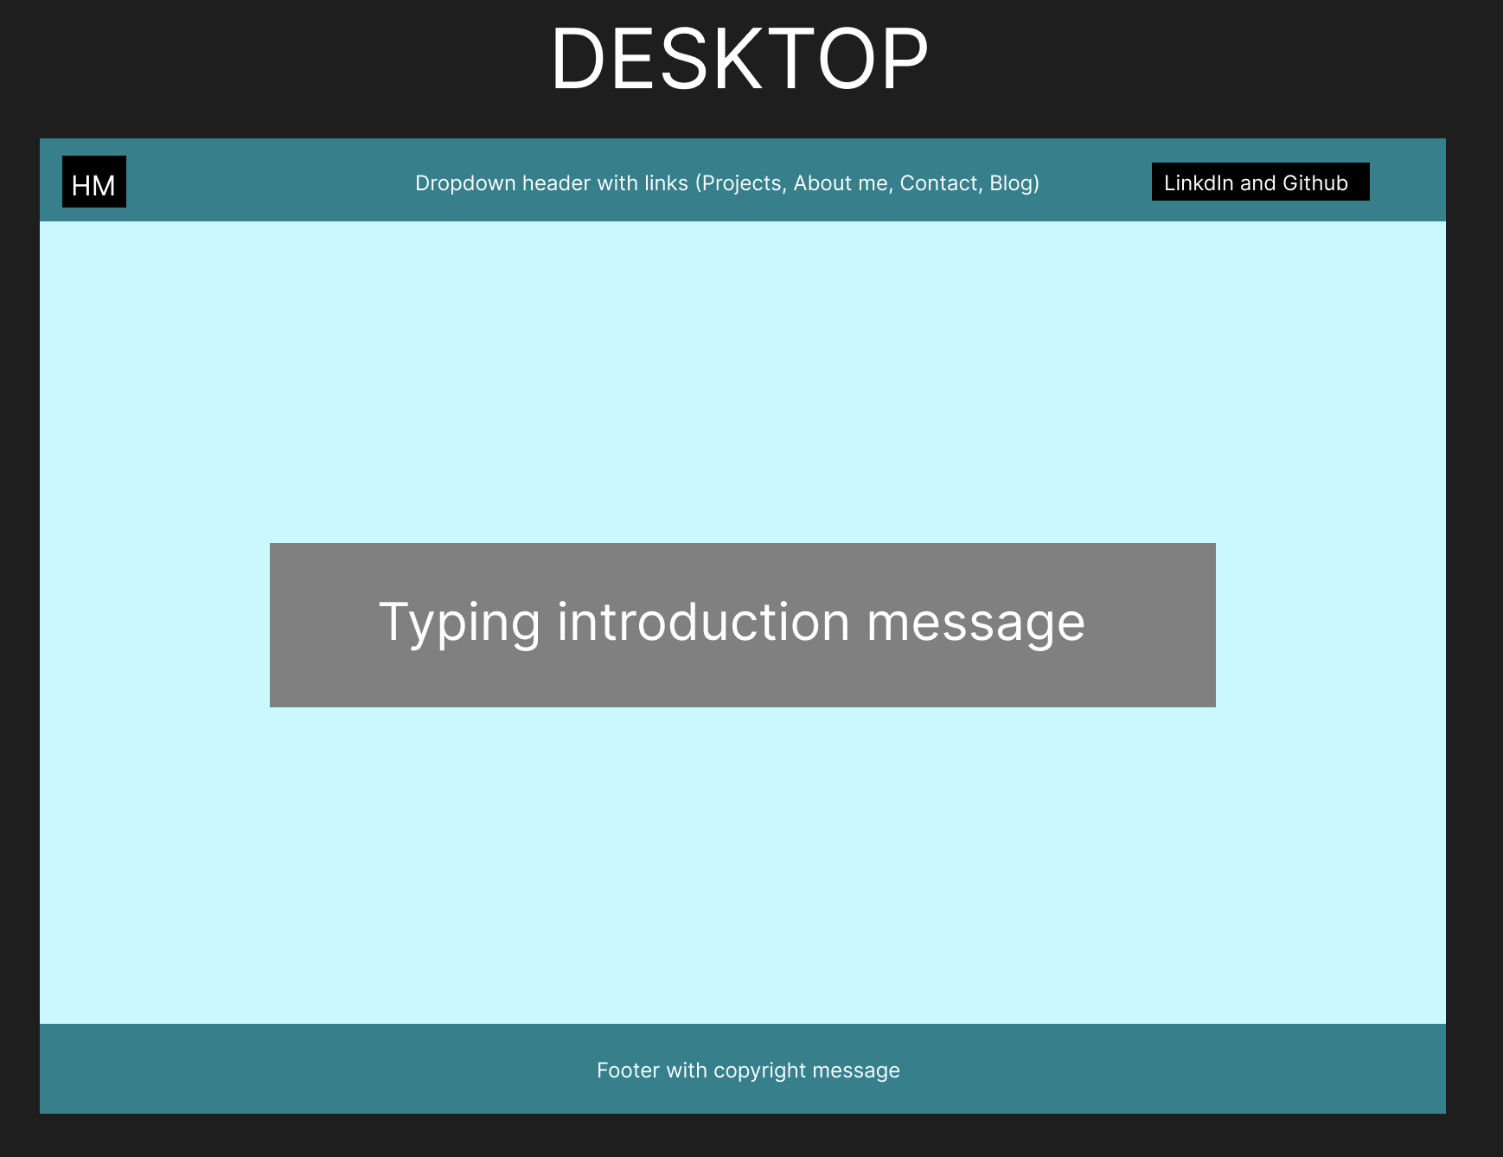
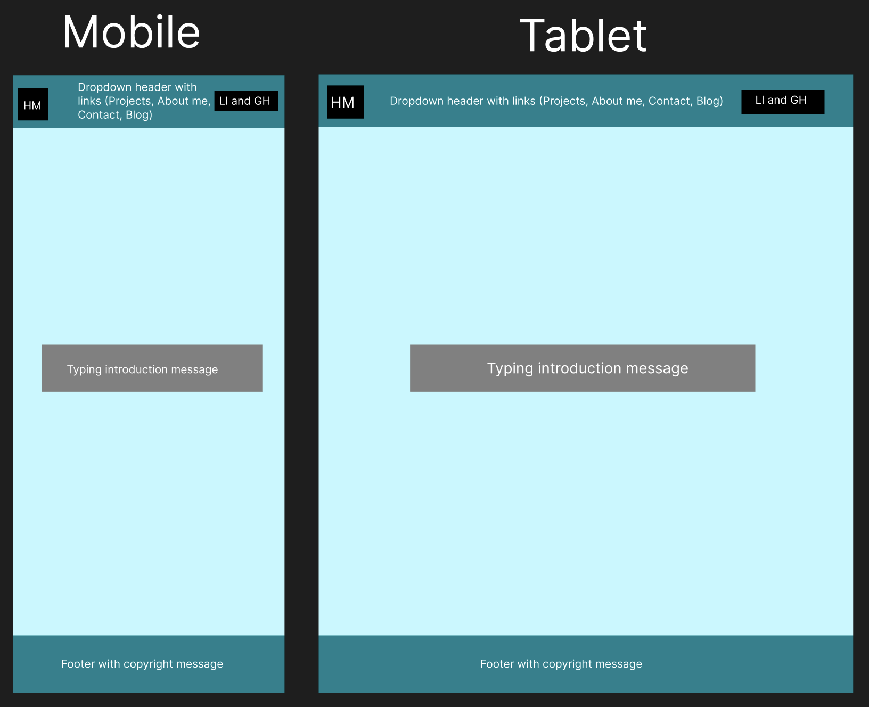
Homepage - Wireframes

Slide 8
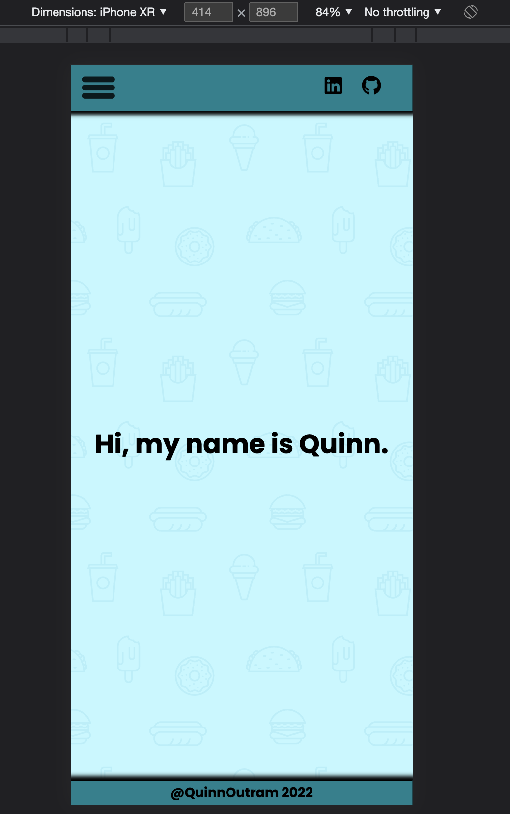
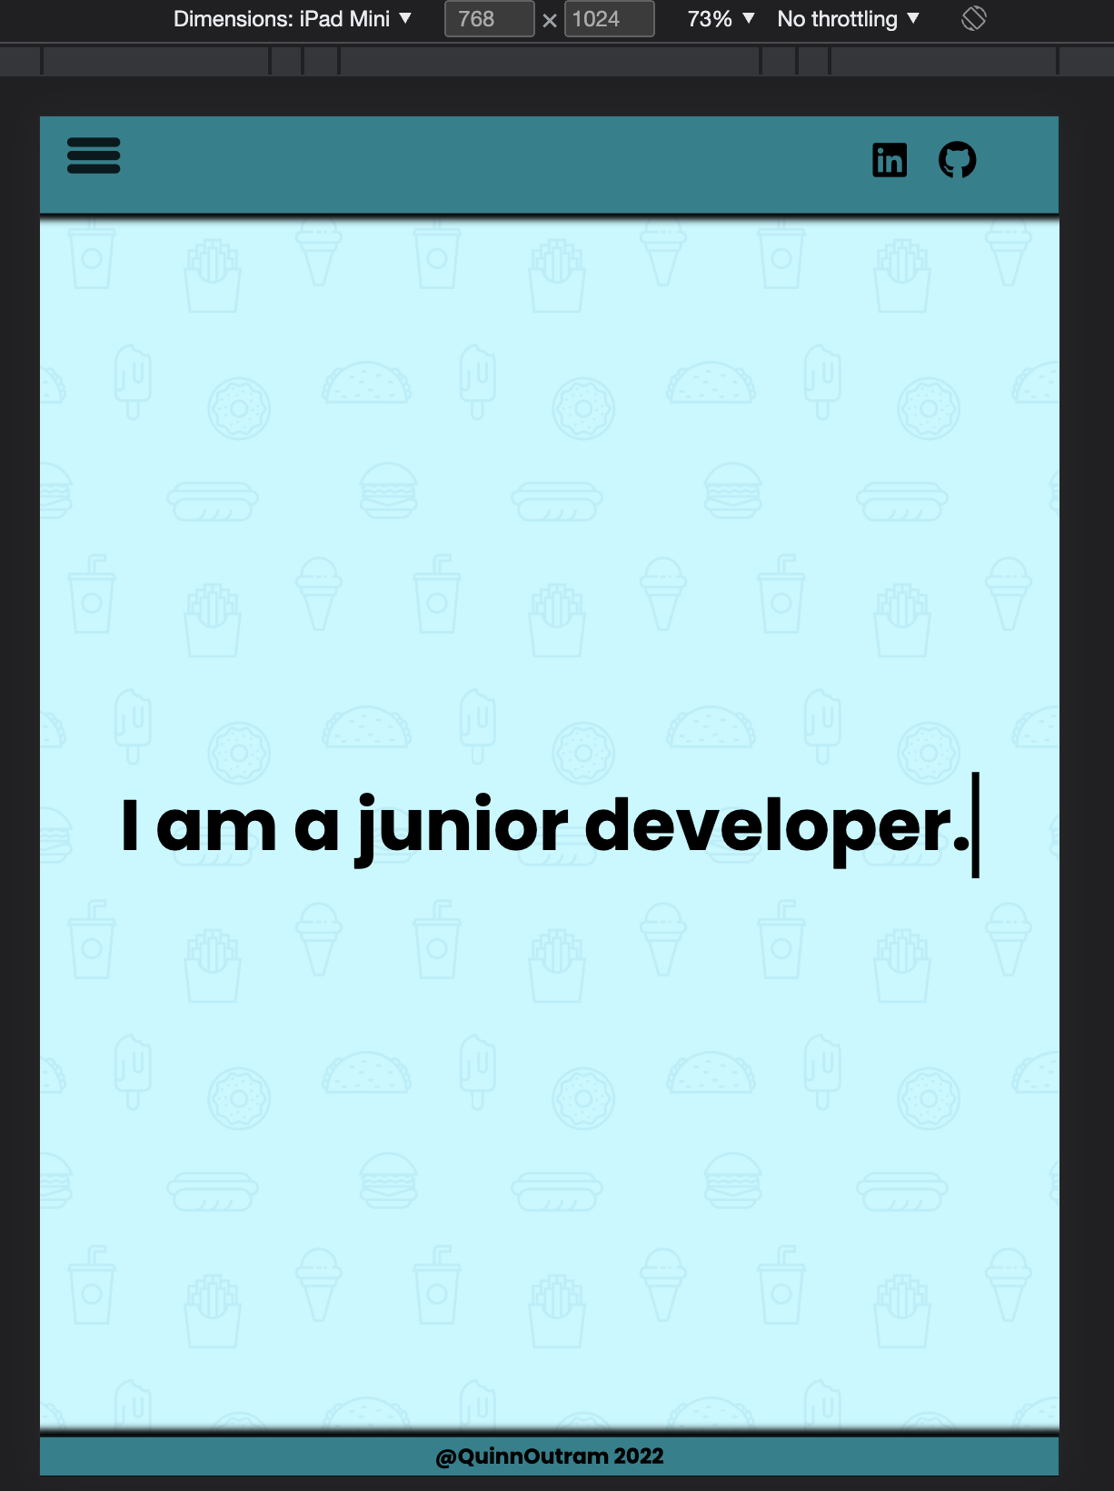
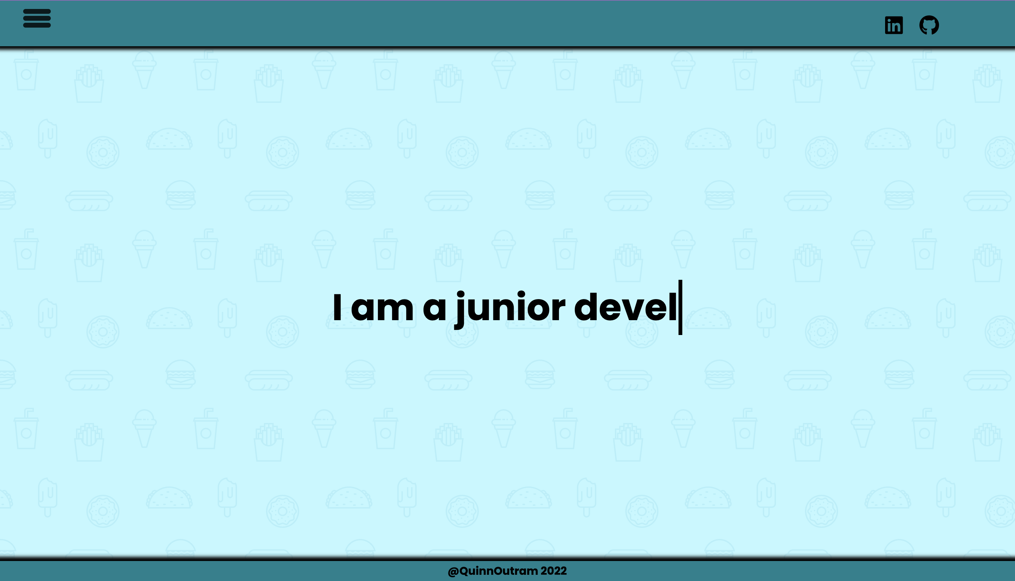
Homepage – Result
Phone
Tablet
Desktop

Slide 9
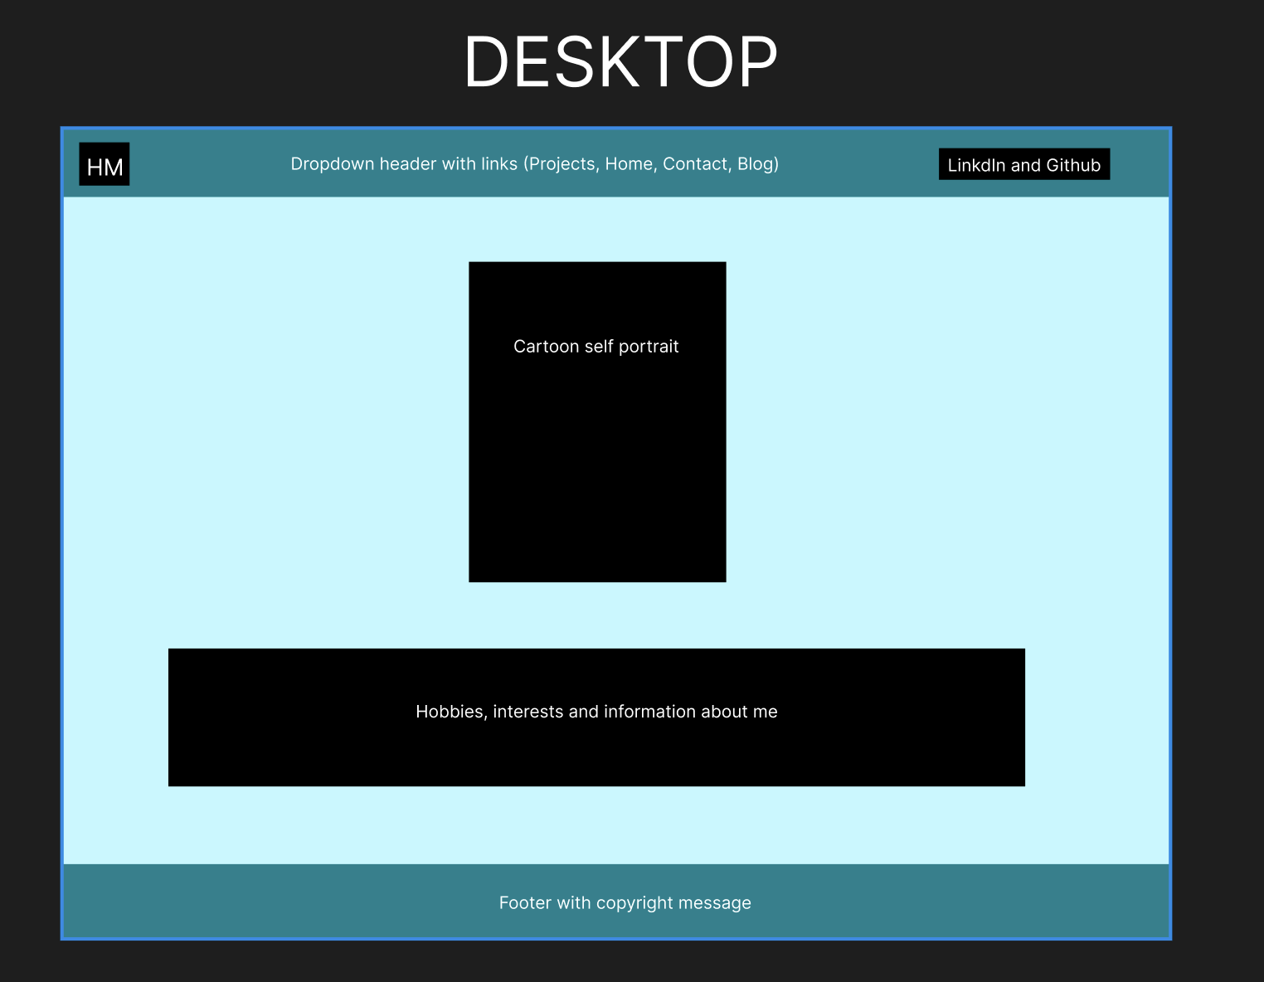
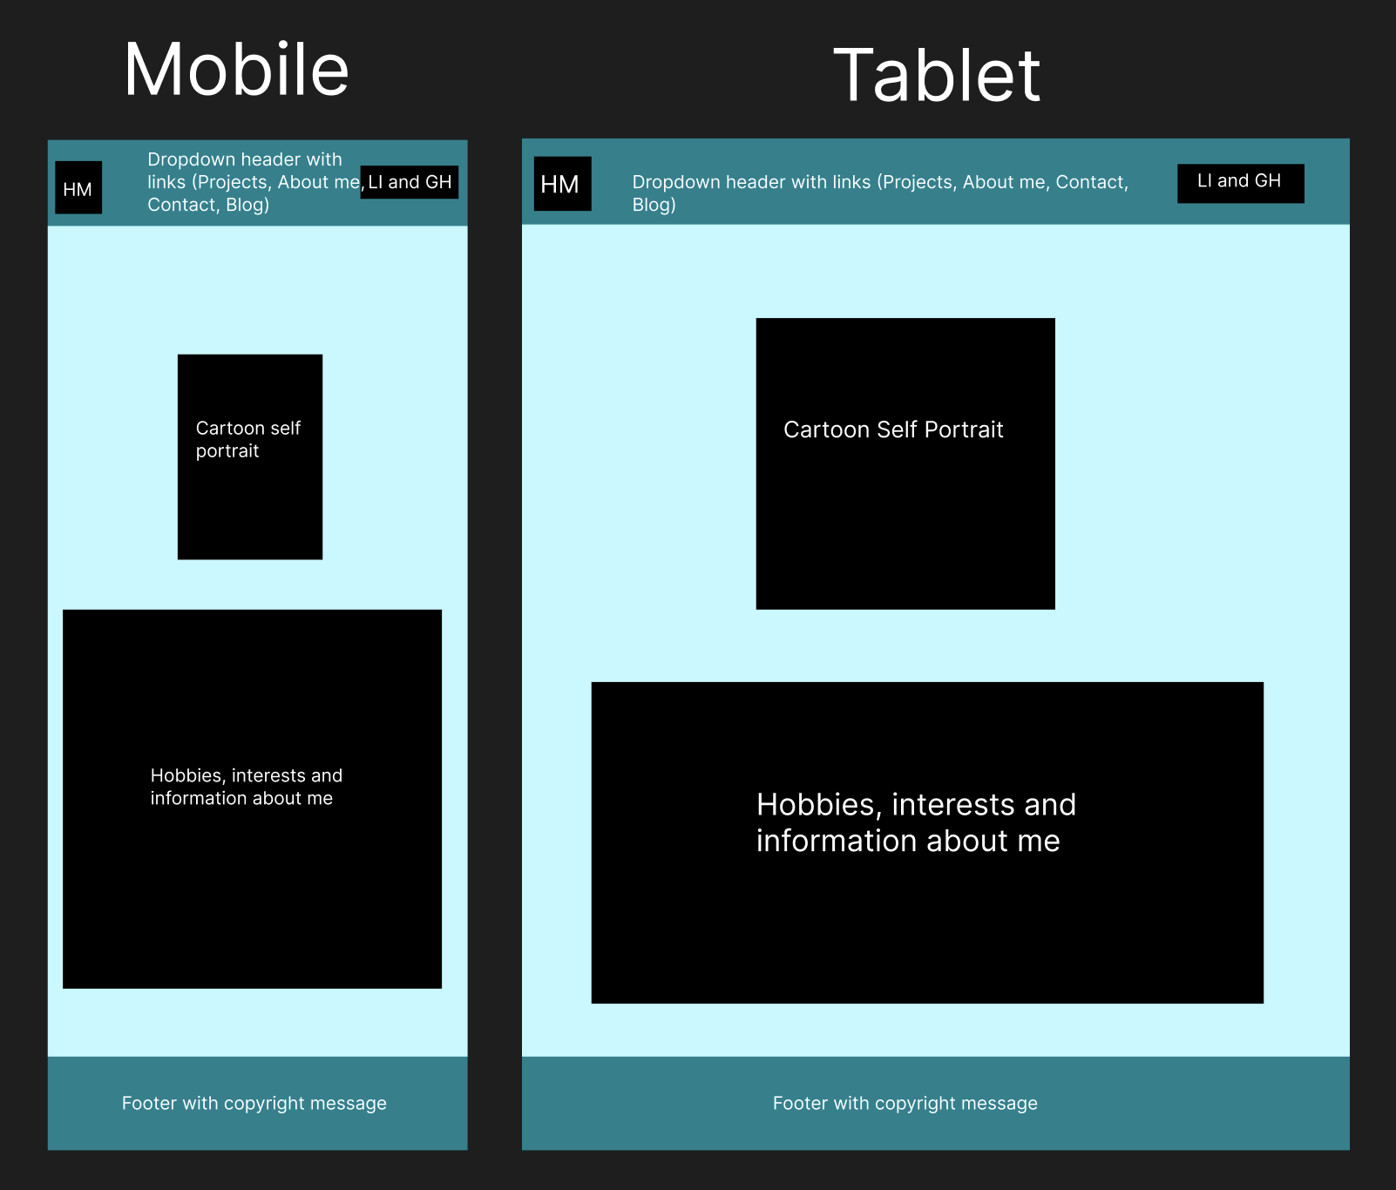
About Me - Wireframes

Slide 10
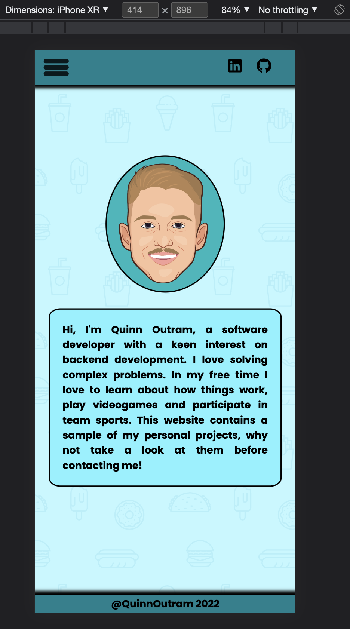
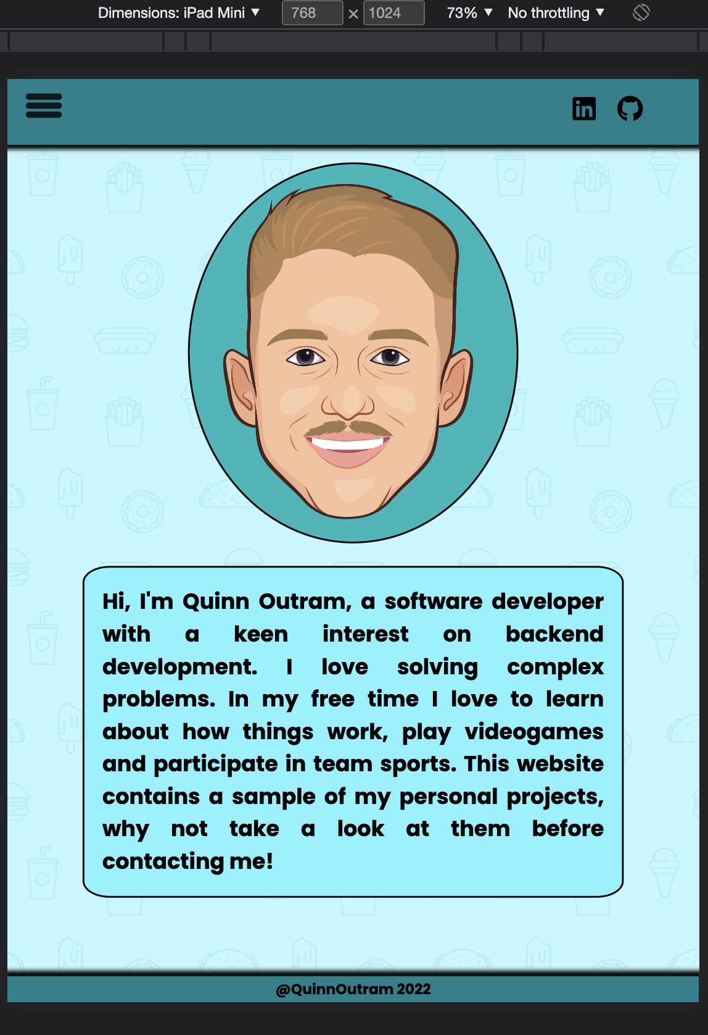
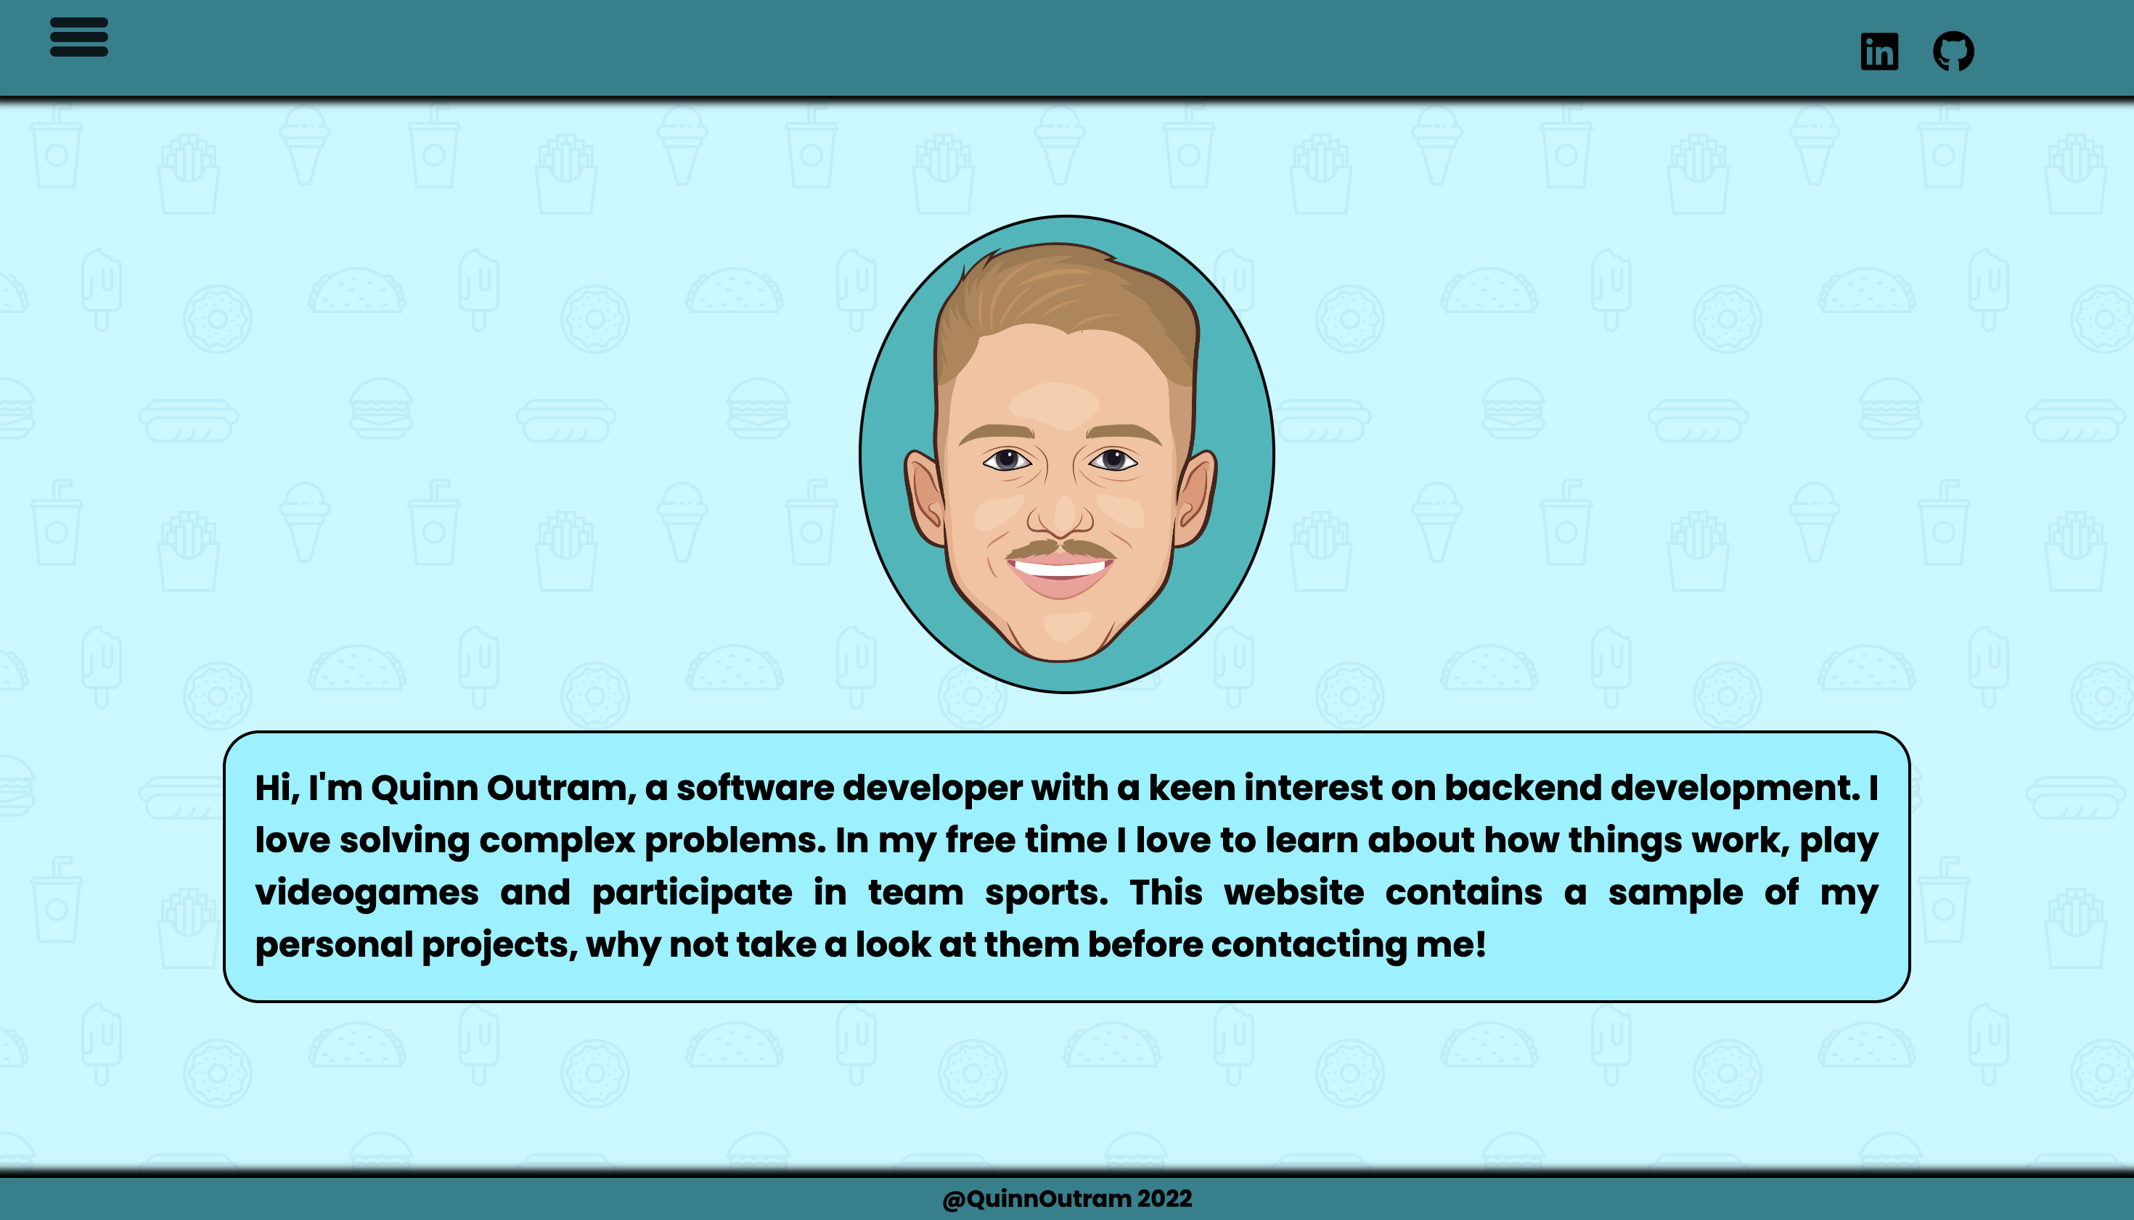
About Me - Result
Phone
Tablet
Desktop

Slide 11
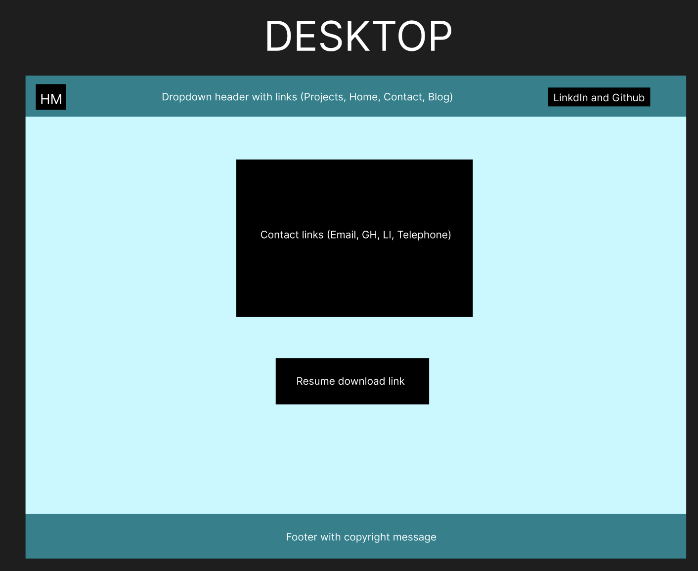
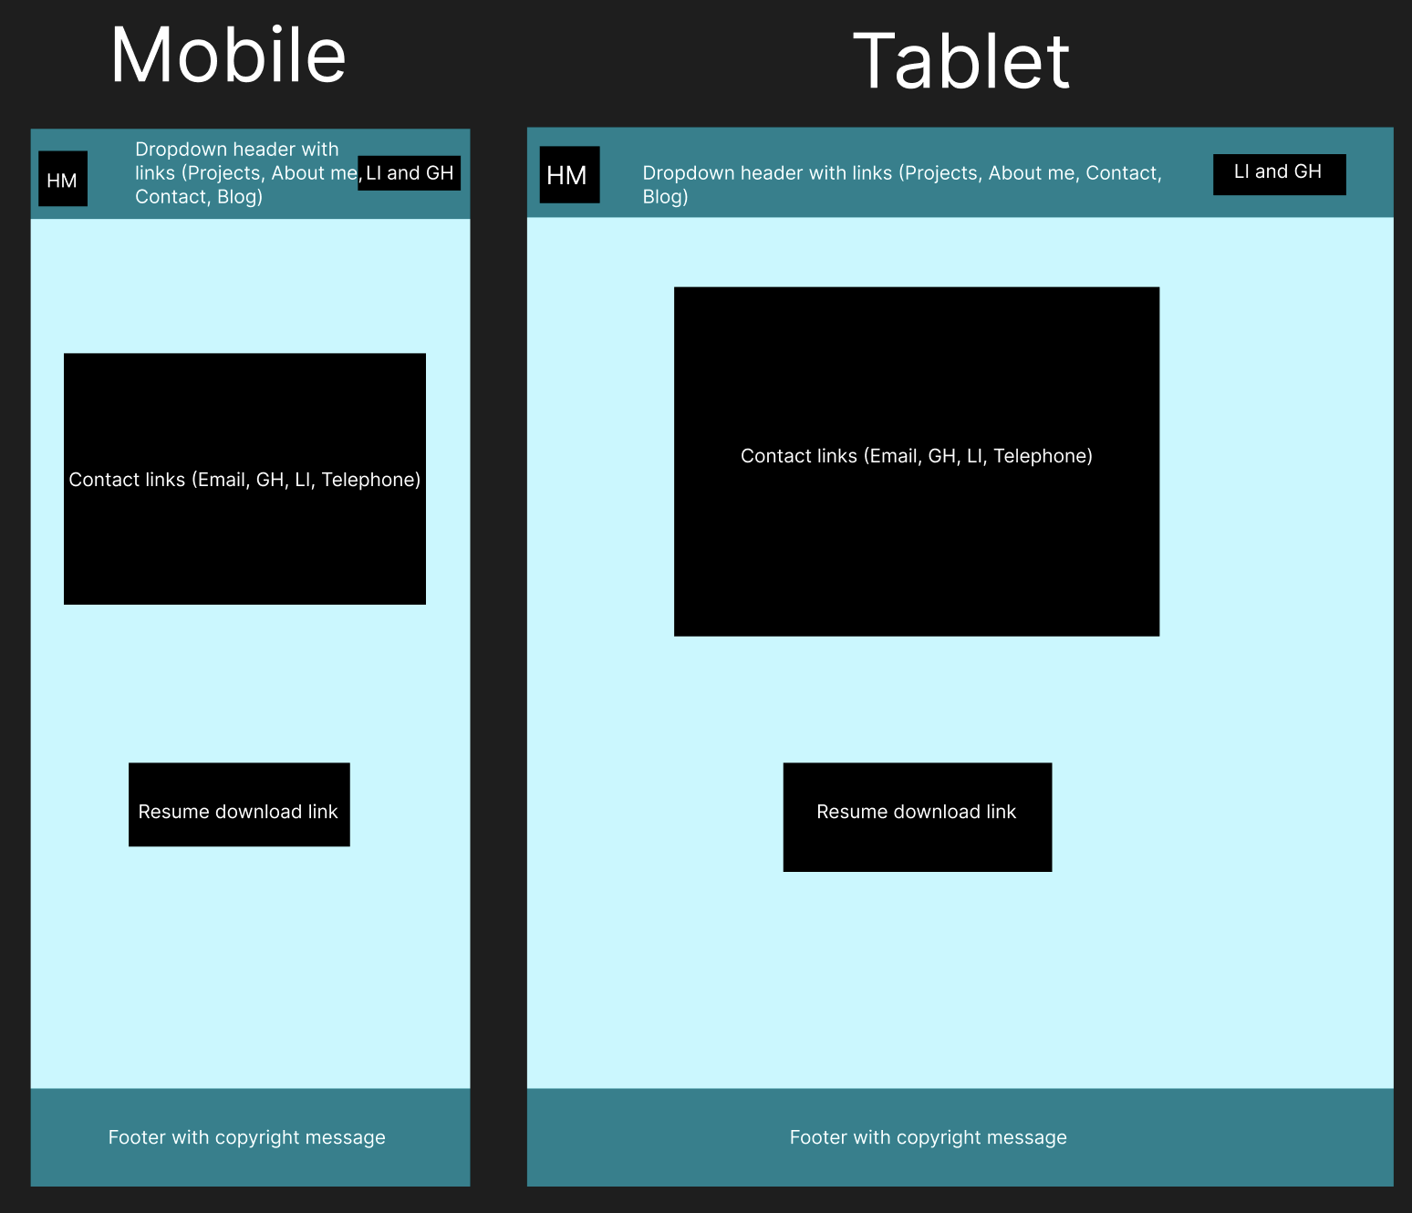
Contact – Wireframes

Slide 12
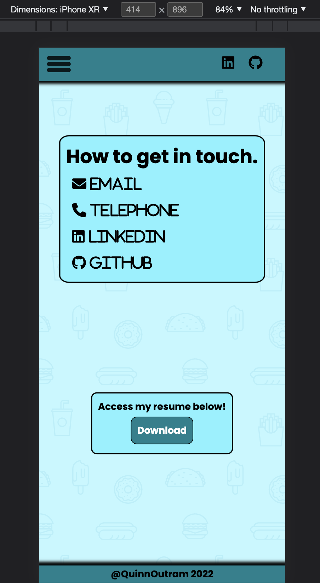
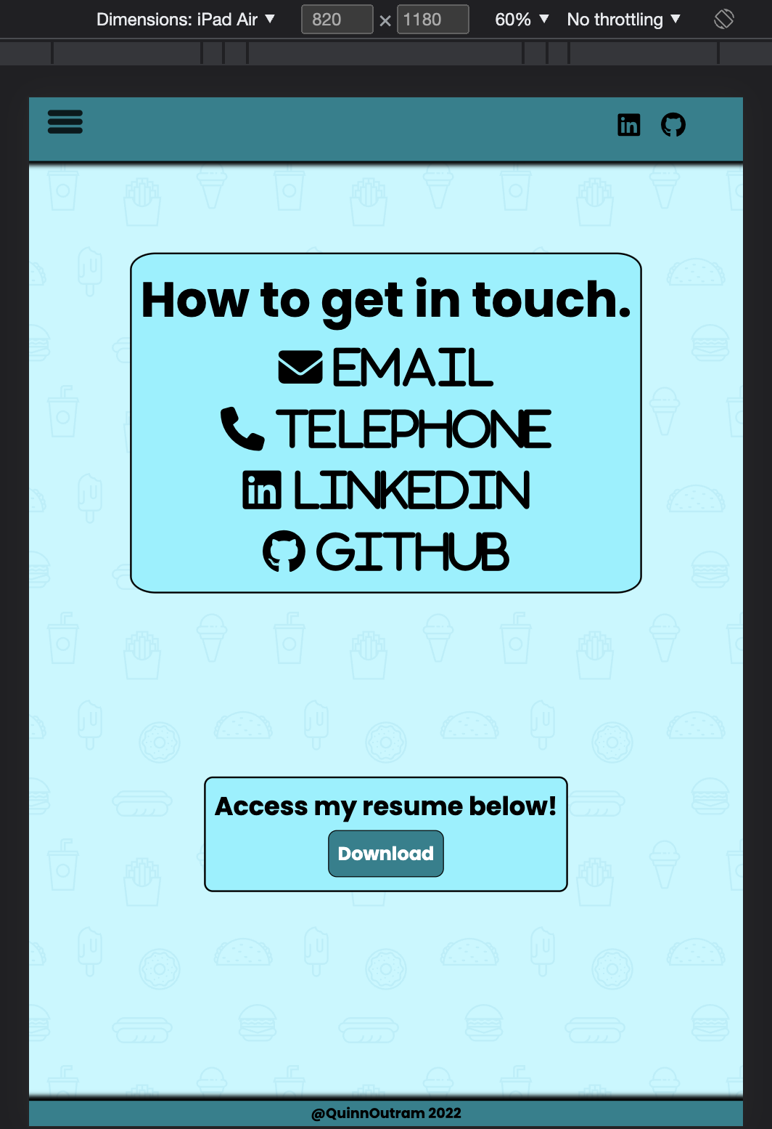
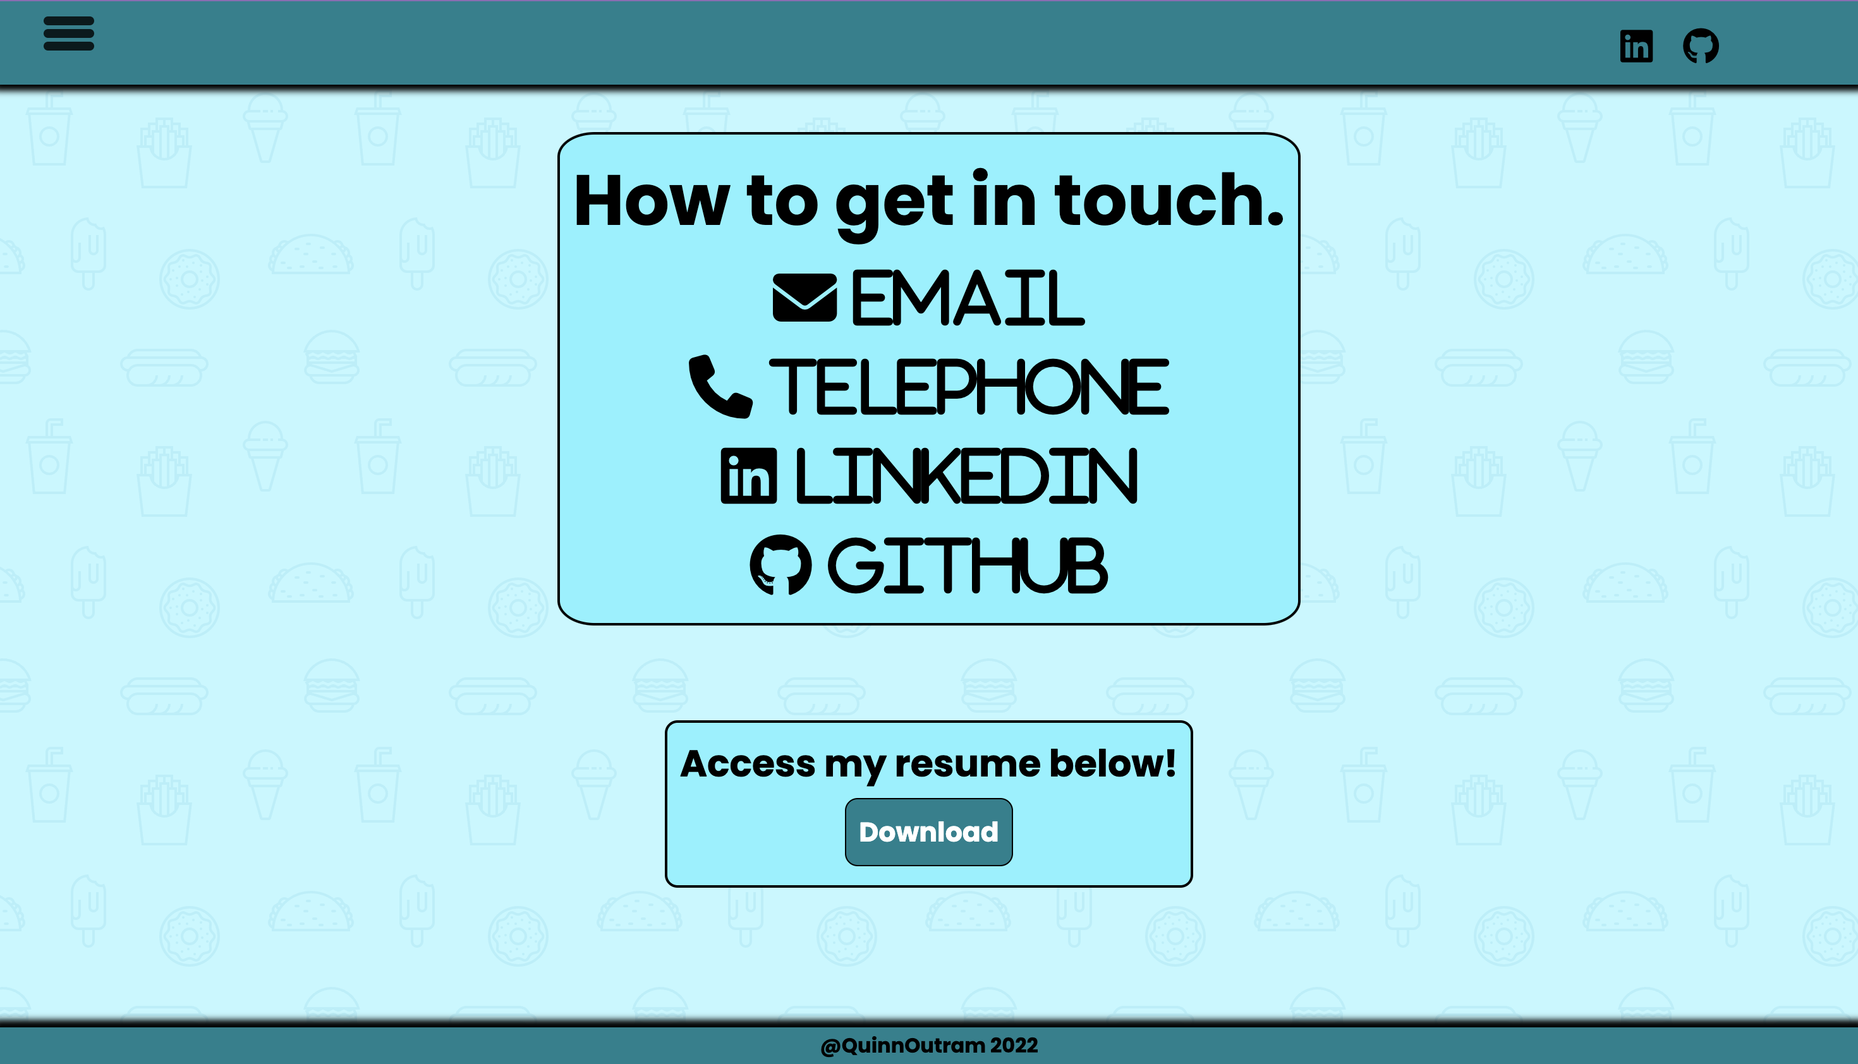
Contact - Result
Phone
Tablet
Desktop

Slide 13
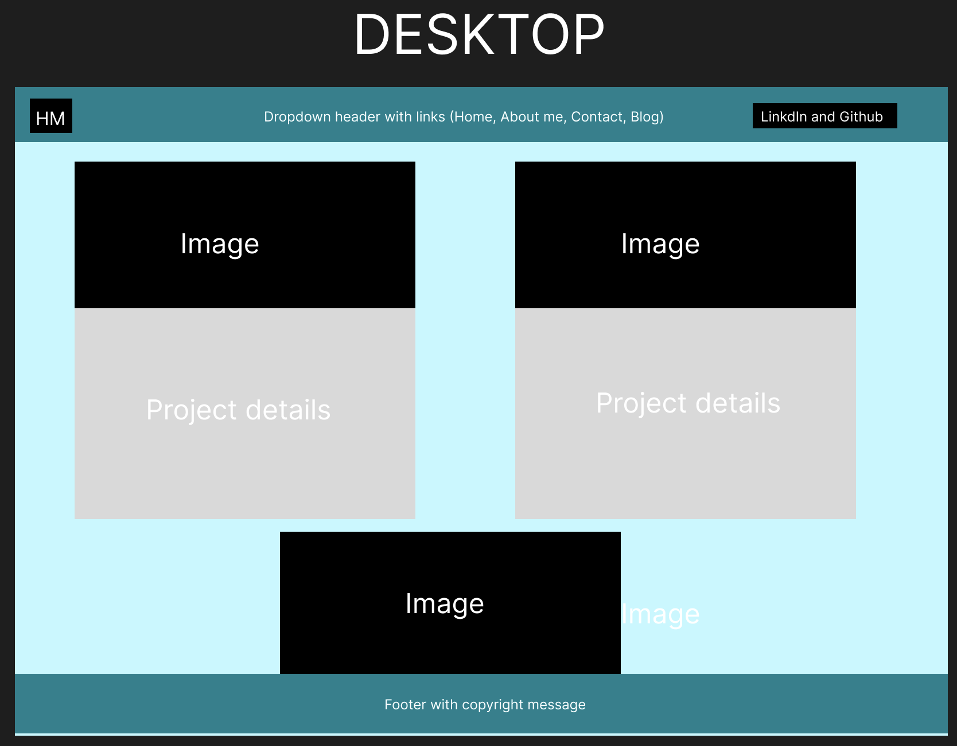
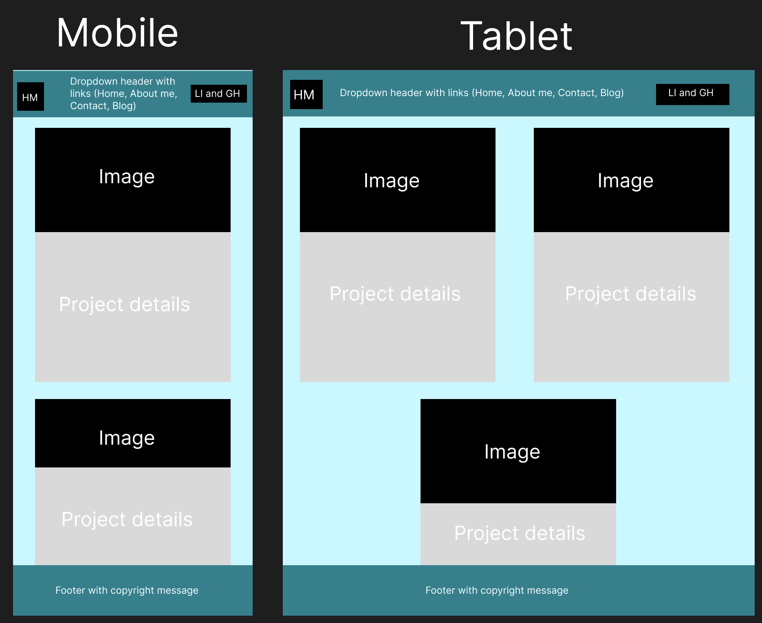
Projects - Wireframes

Slide 14
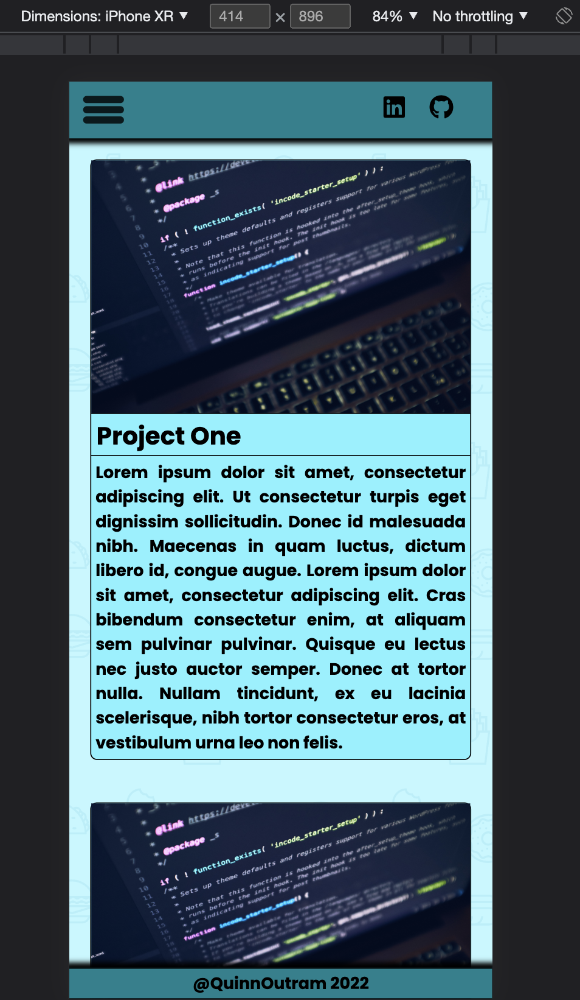
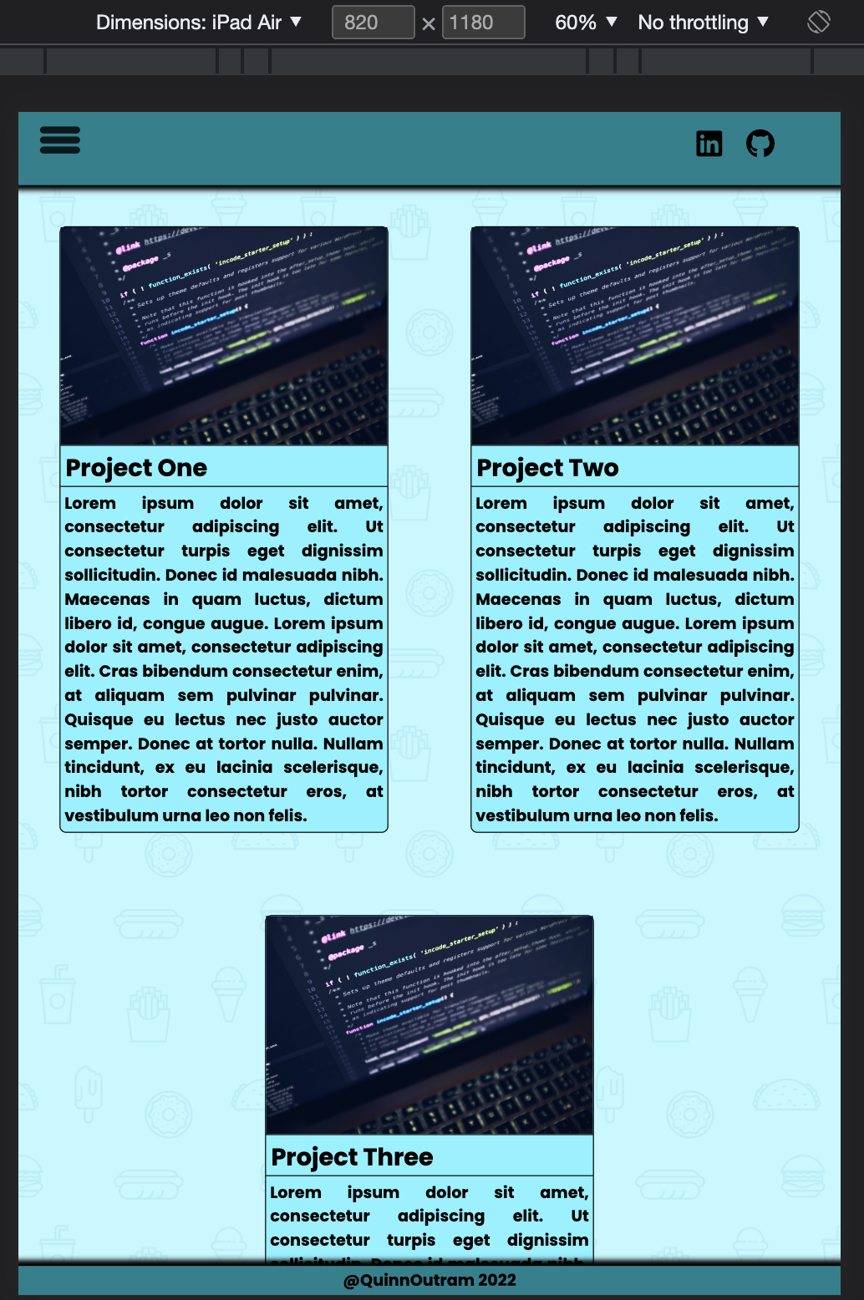
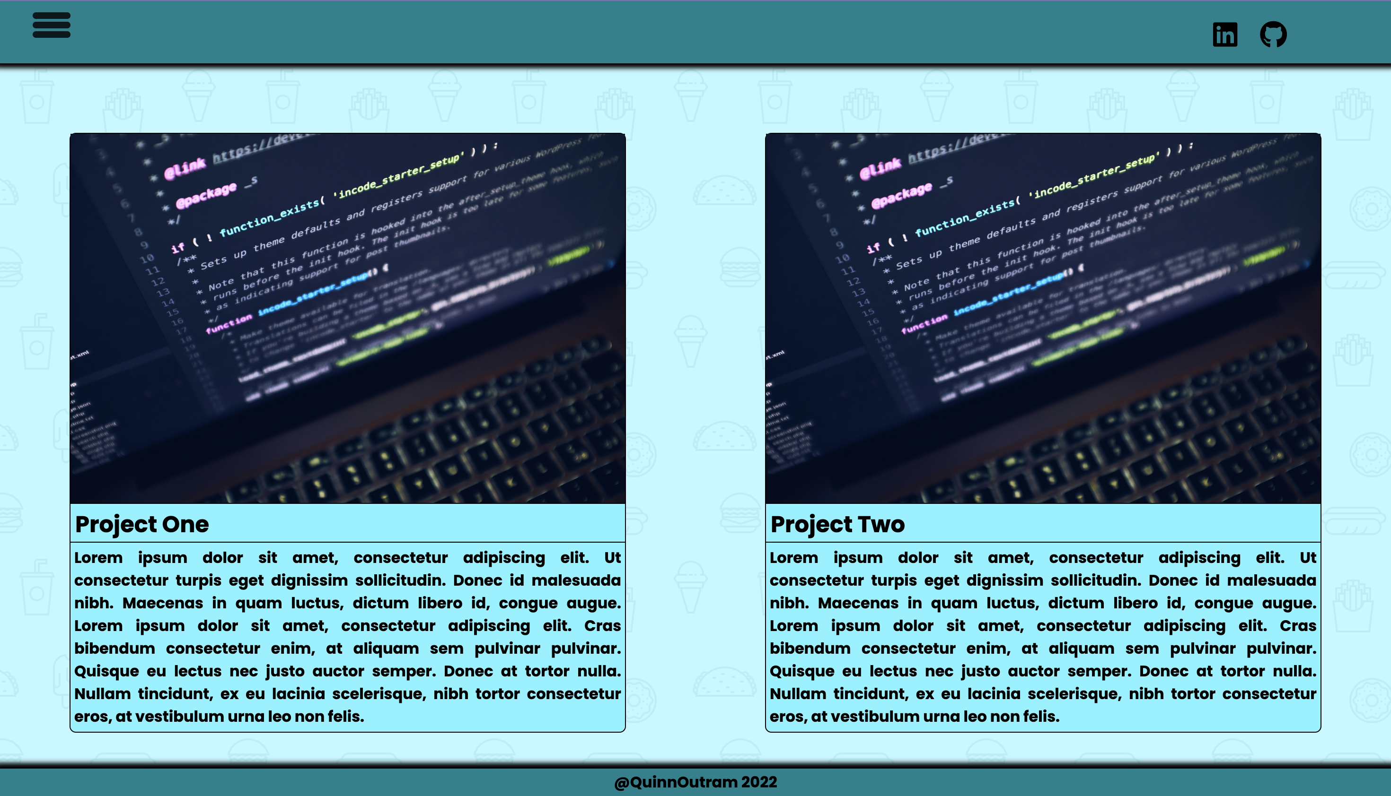
Projects - Result
Phone
Tablet
Desktop

Slide 15
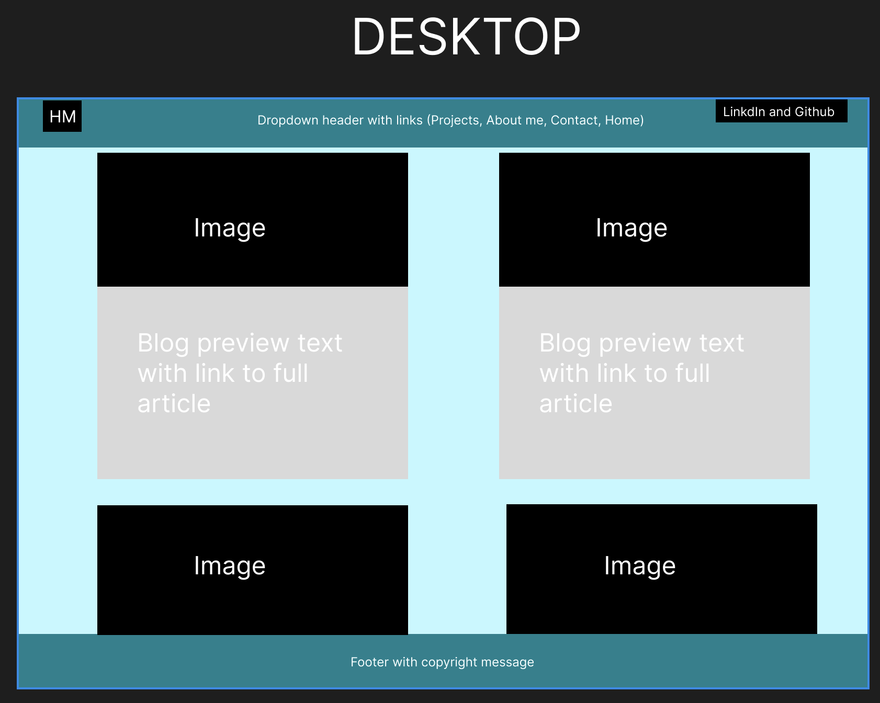
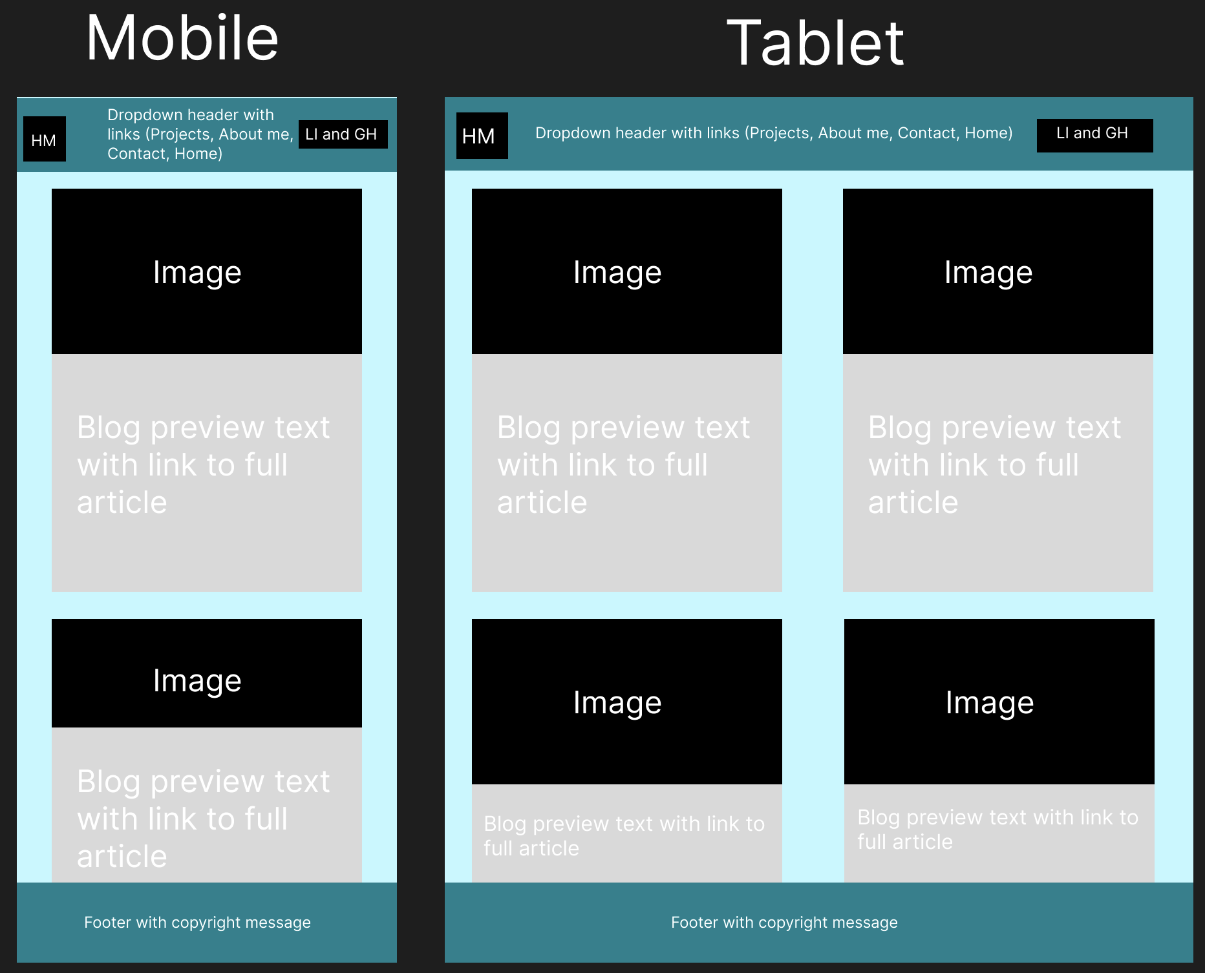
Blog – Wireframes

Slide 16
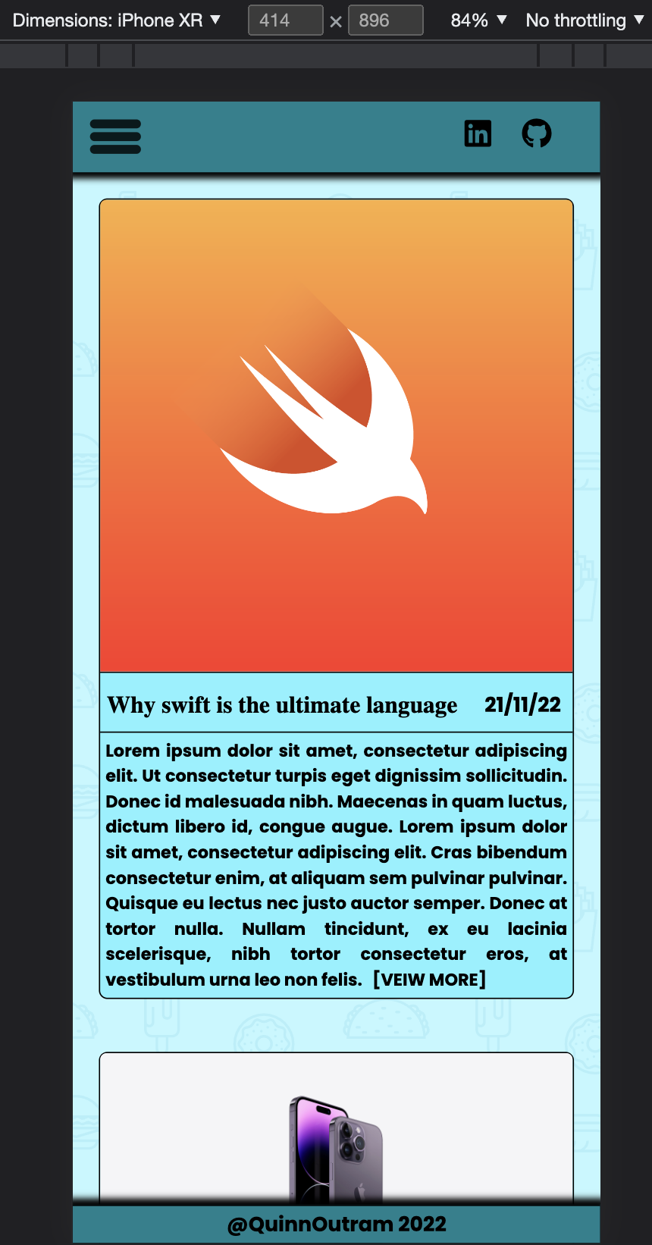
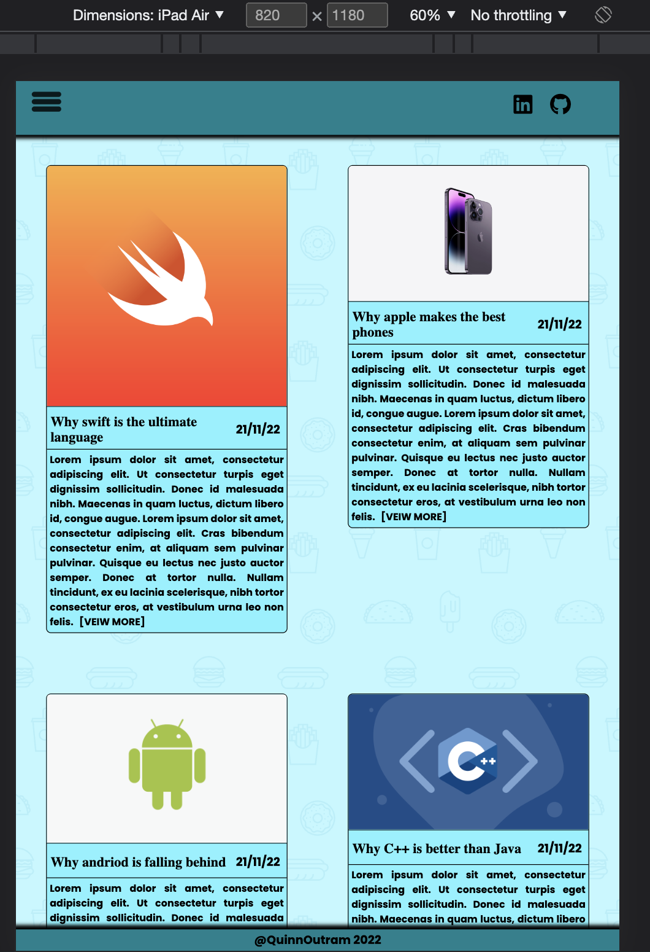
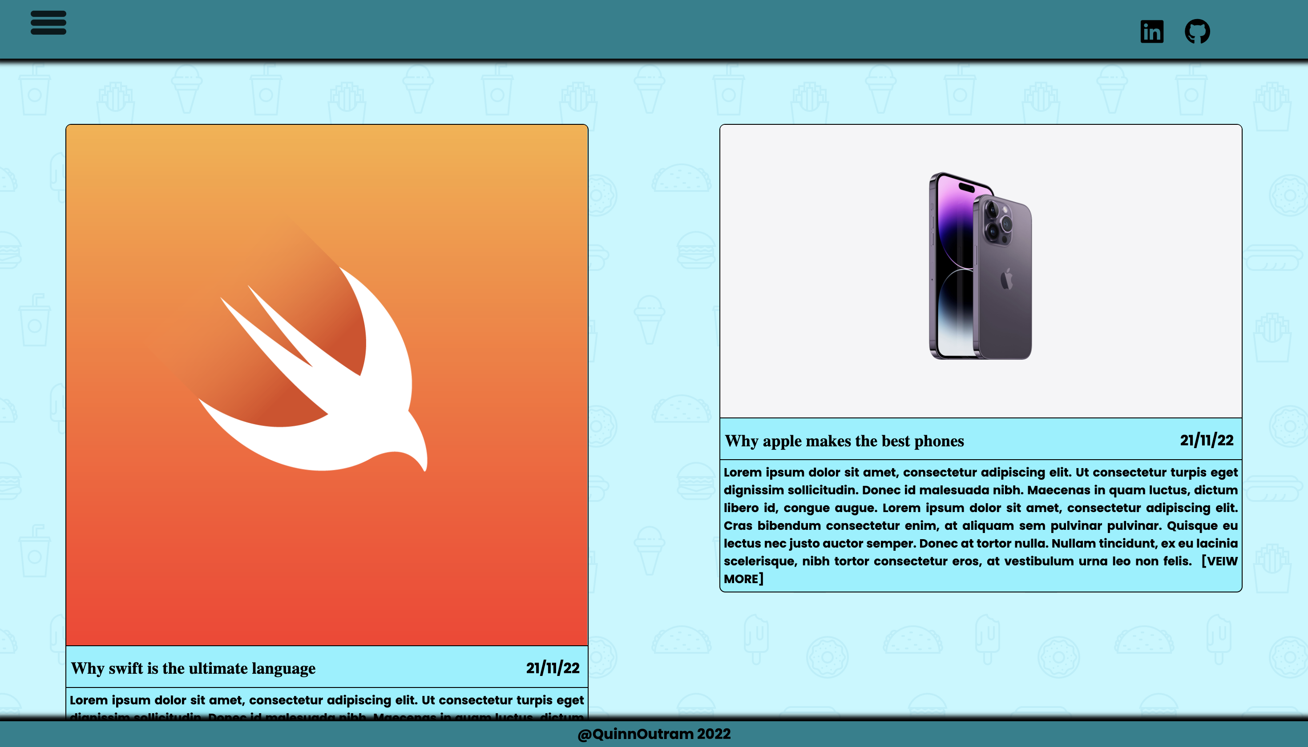
Blog - Result
Phone
Tablet
Desktop

Slide 17
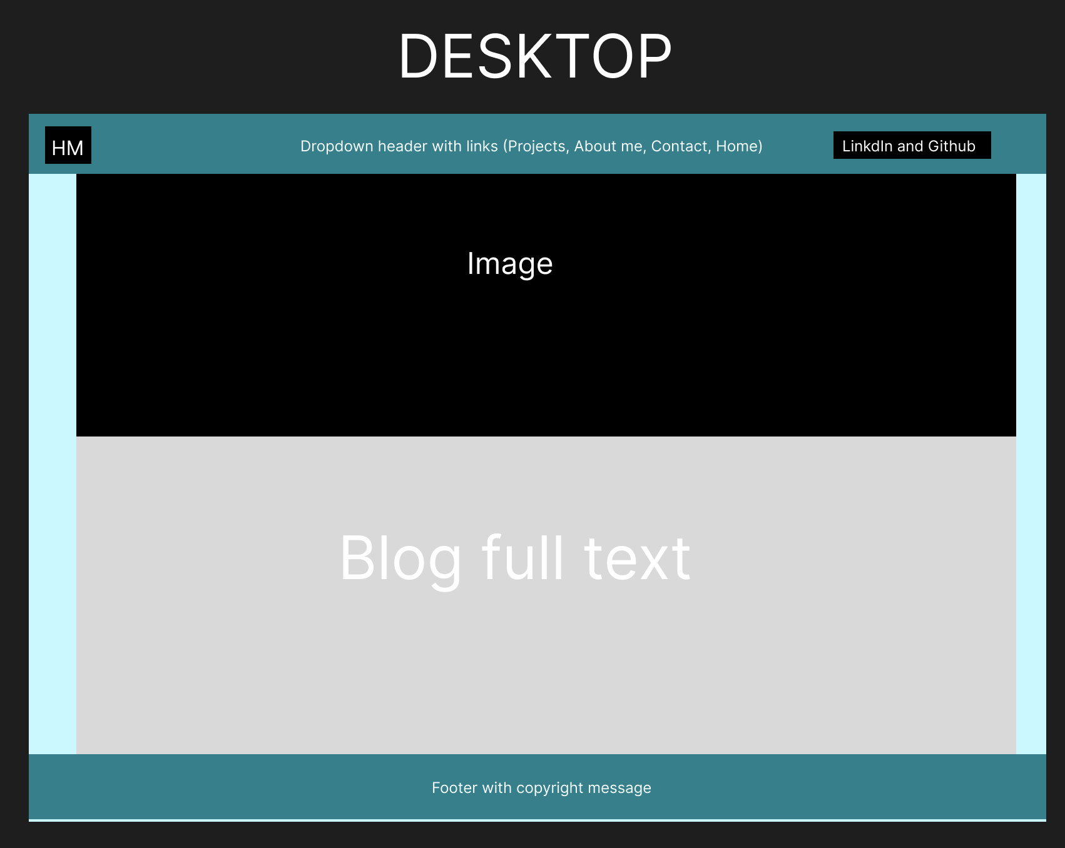
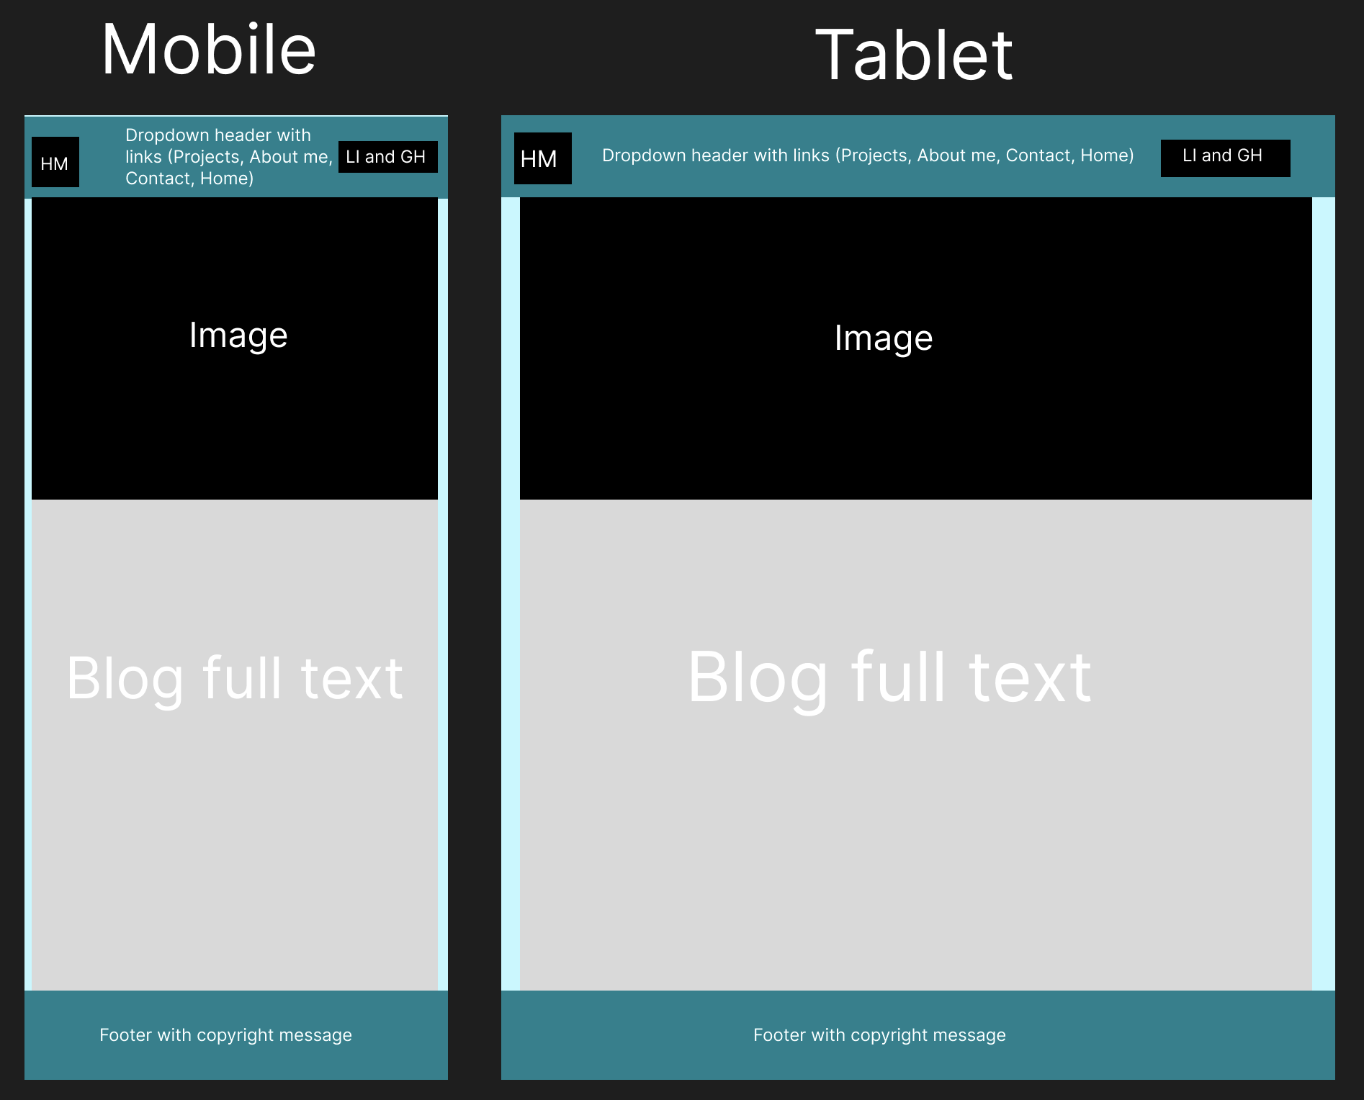
Blog Post - Wireframes

Slide 18
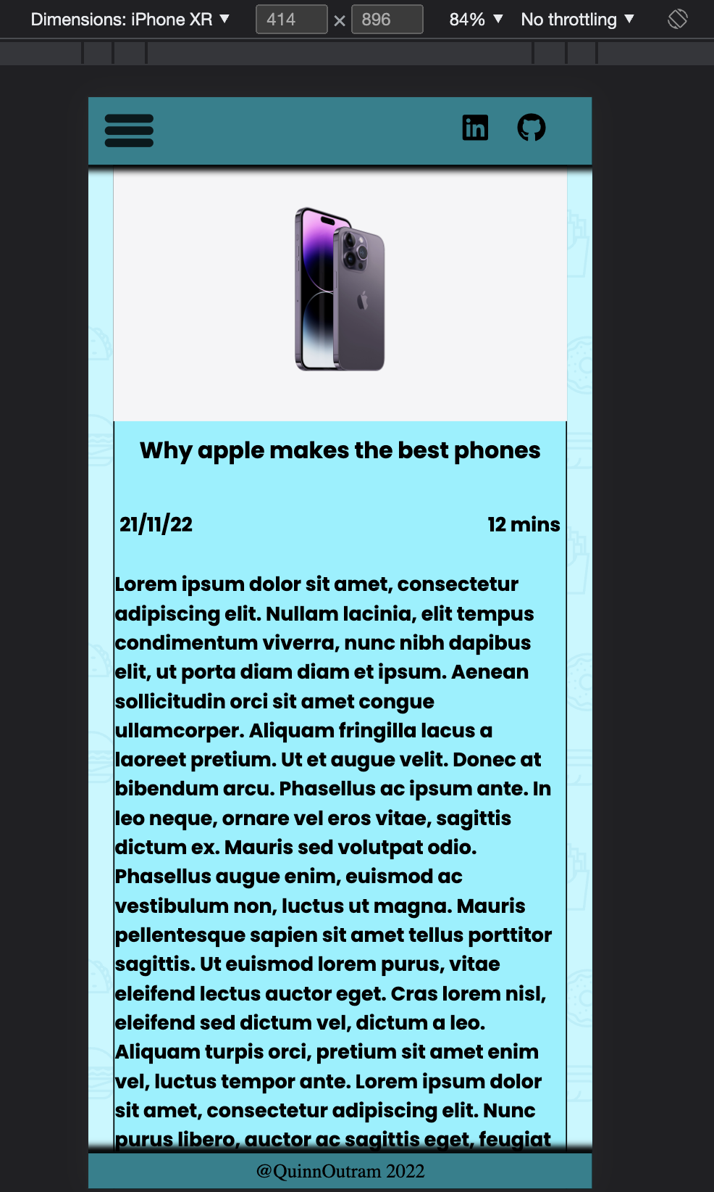
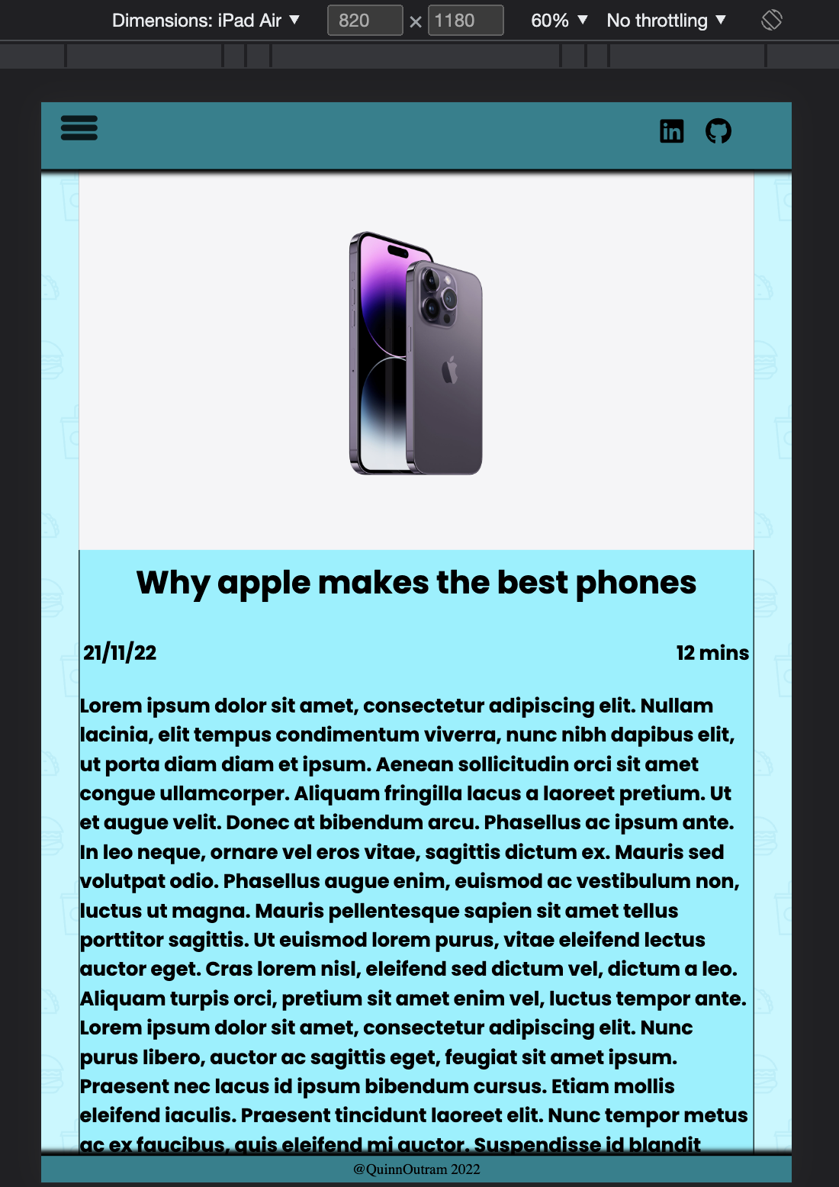
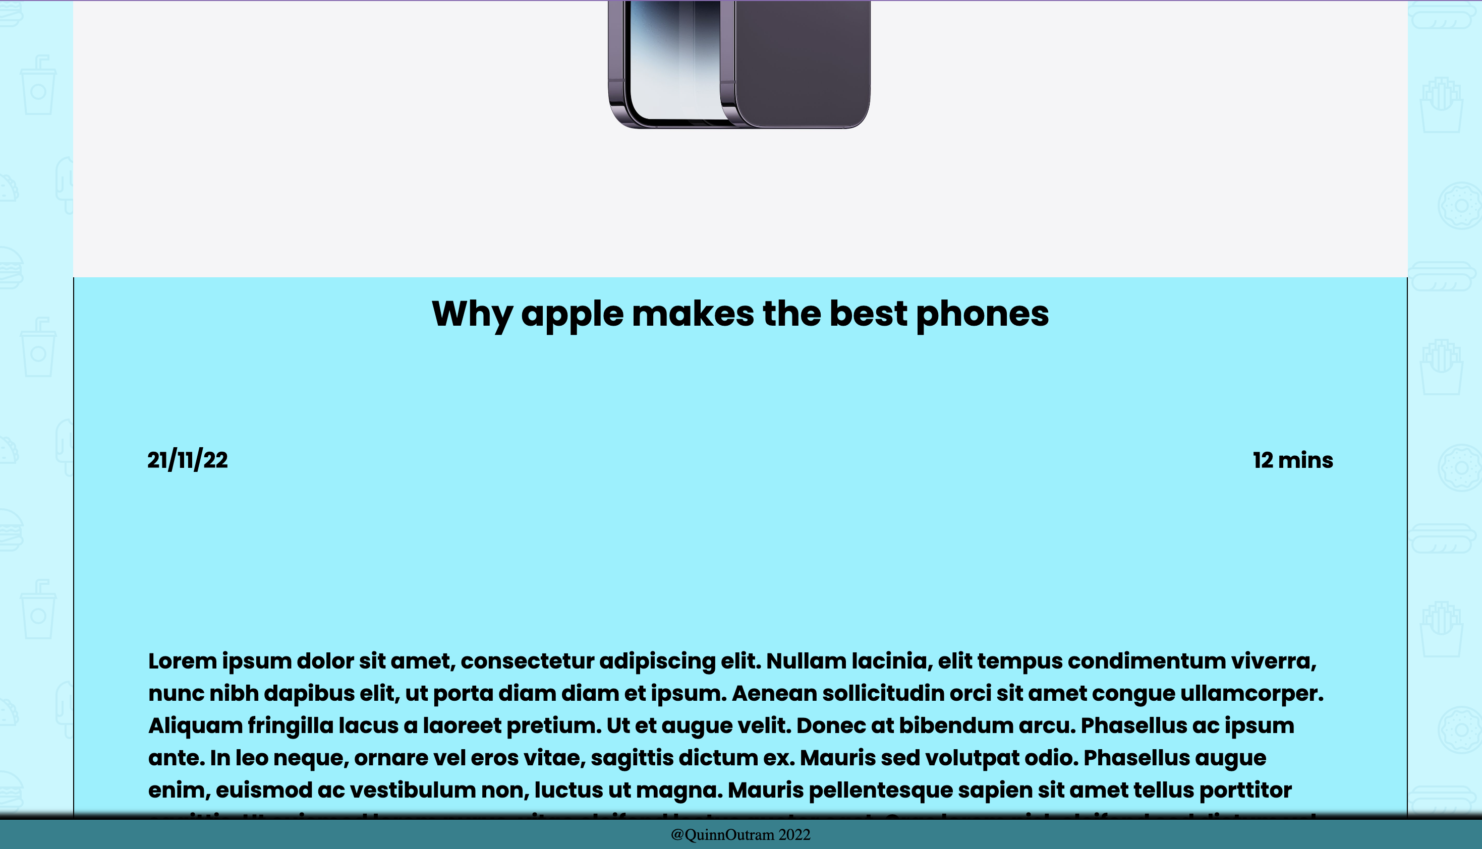
Blog Post - Result
Phone
Tablet
Desktop

Slide 19
Wireframe Explanations
Throughout the wireframes the same color scheme was used which is cyan blue
As a design principle minimal change was attempted between different viewpoints using modular flexbox elements to adjust size between devices
Common elements such as the header and footer required minimum change across several viewpoints as they conformed to the new viewpoints very nicely
A common background was kept throughout the whole website to ensure conformity and a general style
Fonts were also kept as consistent as possible throughout the website

Slide 20
Difficult/Interesting parts
Difficult
The hamburger menu was difficult to implement I had to play with absolute vs relative positioning
Making stuff look pretty on all device viewpoints was a difficult in the end I figured out I needed two separate viewpoints for desktop one being for those with larger screens.
Interesting
Figuring out how to do the typing animation via JavaScript was super interesting and beneficial in the end I created a function which took in an index for the array of prompts as well as a direction/letter index(which I used to slice the string between index 0 and the iterated letter index) I had to use a loop to make this happen.

Slide 21
Deployment/Tech Stack
Tech Stack:
JavaScript
HTML
CSS
Git
Netifly
The website was deployed using netifly and can be accessed via this link:
https://frabjous-churros-a13eb7.netlify.app

